Slide 1



RAILWAY MANAGEMENT SYSTEM Submitted
by G. keerthi Reddy (192224165) P. Arthi (192224159)
Guided by Dr . RAJASEKARAN. A Associate professor
Department of Big Data & Network Security
Department of Computer Science and Engineering,
Saveetha School of Engineering, SIMATS
Thandalam , Chennai
March – 2024

Slide 2
ABSTRACT:
The Railway Reservation System facilitates the passengers to enquire about the trains available on the basis of source and destination, Booking and Cancellation of tickets, enquire about the status of the booked ticket, etc.
The aim of case study is to design and develop a database maintaining the records of different trains, train status, and passengers.
The ticket booking system has gradually evolved from paper ticket to online booking and smart card system. Later this ticket will be evaluated by the ticket examiner.
since there are lot of passengers travelling in the train, there are also lot of passengers whose name is on waiting list and they have to share their seat. There are also cases where a passenger suddenly cancels the ticket and that seat will be left empty, later this seat will be allotted to any random person in the waiting list.
In this paper, we tried to provide the solution for the problem of unfair seat allocation for the passengers in the waiting list. In lot of cases, when a ticket is cancelled the seat will not be provided to the passenger whose name is first in the waiting list, this may be because of the corruption or due to the lack of information.

Slide 3
INTRODUCTION:
The main purpose of maintaining database for Railway Reservation System is produce the manual errors involved in the booking and cancelling of tickets and make it convenient for the customers and providers to maintain the data about their customers and also about the seats available at them.
Every Indian can been %proudly say that the "Indian railway is the World second largest railway system ."If going by figures it 6853 station and 63028 Kilo meters of train distance carrying a load of 37840 %Passengers and around 500 tons of freight annual .
It is not only reservation but cancellation can also be done through this system at the process .This being a big site in terms of improvement in the railway system.
By harnessing the power of technology, our Railway Management System optimizes resource utilization, minimizes delays, and enhances overall service quality. From station managers to passengers, everyone benefits from the intuitive interface and robust features that make traveling by rail a pleasure.
From seamless online booking to real-time updates on train schedules, we ensure that every journey is smooth and stress-free. Safety is paramount, with enhanced measures in place to protect passengers and staff at every step of the way.

Slide 4

OBJECTIVES :
The objective of railway reservation system is to give structural design to railway system.
The project provides functionality and flexibility to railway system such that one can operate that system easily and efficiently.
This project also provides a complete set of solutions for some common and specific are as of work in the railways.
ADVANTAGES:
Track status will be available online on website.
Dependency on manual work will be reduced.
Robots embedded with temperature sensors can be useful to know the atmospheric conditions of certain location.
Railways become more reliable
Costing for implementing this concept will not cost much.
Speed of the Bot can be controlled online.
With some modification in the design it can be made aerial in emergency cases.
It does not require more electricity.

Slide 5
METHODOLOGY:
1.Requirement Analysis:
Conduct thorough research to understand the specific needs and challenges of the railway system.
Gather requirements from stakeholders including railway authorities, staff, and passengers.
2.System Design:
Design the architecture of the Railway Management System based on gathered requirements.
Create use case diagrams, class diagrams, and sequence diagrams to visualize system behavior and interactions.
3.Development:
Develop the Railway Management System according to the finalized design and requirements.
Implement modules for key functionalities such as scheduling, ticketing, resource management, and reporting.
4.Testing:
Conduct comprehensive testing of the system to identify and rectify any defects or issues.
Perform unit testing, integration testing, and system testing to validate the functionality, performance, and reliability of the system.
5.User Feedback :
Gather feedback from railway authorities, staff, and passengers on their experience with the system.
Incorporate feedback into future iterations of the system to improve usability, efficiency, and user satisfaction

Slide 6
PROGRAM:
import matplotlib.pyplot as plt
class Train:
def __init__(self, name, source, destination, seats):
self.name = name
self.source = source
self.destination = destination
self.seats = seats
class RailwayManagementSystem:
def __init__(self):
self.trains = []
self.seats_history = {}
def add_train(self, name, source, destination, seats):
train = Train(name, source, destination, seats)
self.trains.append(train)
self.seats_history[name] = [seats]
def view_trains(self):
print("Available Trains:")
for train in self.trains:
print(f"{train.name}: From {train.source} to {train.destination}, Seats available: {train.seats}")

Slide 7
def book_ticket(self, train_name, seats):
for train in self.trains:
if train.name == train_name:
if train.seats >= seats:
train.seats -= seats
self.seats_history[train_name].append(train.seats)
print(f"Ticket booked successfully for {seats} seats in train {train_name}")
else:
print("Sorry, not enough seats available.")
return
print("Train not found.")
def cancel_ticket(self, train_name, seats):
for train in self.trains:
if train.name == train_name:
train.seats += seats
self.seats_history[train_name].append(train.seats)
print(f"{seats} seats cancelled successfully for train {train_name}")
return
print("Train not found.")
def plot_seat_history(self, train_name):
if train_name in self.seats_history:
plt.plot(range(len(self.seats_history[train_name])), self.seats_history[train_name], label=train_name)
plt.xlabel('Ticket operations')
plt.ylabel('Available seats')

Slide 8
plt.title(f'Available seats for train {train_name}')
plt.legend()
plt.show()
else:
print("Train not found.")
# Example usage:
rms = RailwayManagementSystem()
rms.add_train("Express", "City A", "City B", 100)
rms.add_train("Fast Train", "City B", "City C", 80)
rms.view_trains()
rms.book_ticket("Express", 2)
rms.book_ticket("Fast Train", 3)
rms.cancel_ticket("Express", 1)
rms.view_trains()
# Plot seat history for Express train
rms.plot_seat_history("Express")

Slide 9
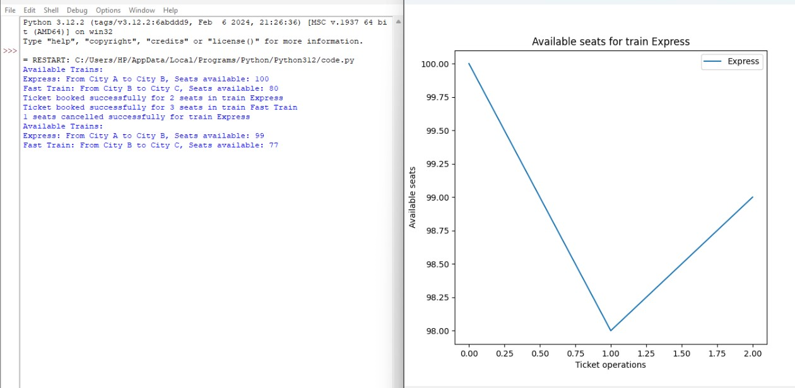
OUTPUT:

Slide 10
RESULT & ANALYSIS:
The provided Python code outlines a simplified railway management system where trains can be added, tickets can be booked, and tickets can be canceled.
Initially, two trains, "Express" and "Fast Train," are added to the system with their respective seat capacities. Upon viewing the available trains, the system displays the train names, their routes, and the number of seats available for booking.
Subsequently, tickets are booked for 2 seats on the "Express" train and 3 seats on the "Fast Train." After a successful booking, the system updates the available seat counts for each train accordingly. Additionally, the system successfully cancels 1 seat on the "Express" train, resulting in an adjustment of available seats.
Finally, a visualization is provided, showing the change in available seats over time for the "Express" train, depicting the impact of booking and canceling tickets on seat availability.
The system offers basic functionalities for managing trains and ticket operations, along with a visual representation of seat availability for monitoring purposes.

Slide 11
CONCLUSION:
while providing railway management system offers a foundational framework for managing trains and ticket operations, it possesses several limitations that hinder its effectiveness for real-world railway management scenarios.
The system lacks scalability, real-time updates, data validation, security measures, transaction management, reporting and analytics capabilities, integration with external systems, user interface enhancements, internationalization, localization, and regulatory compliance
To address these limitations here These efforts should focus on enhancing scalability, ensuring real-time updates and data consistency, implementing robust data validation and security measures, incorporating transaction management for data integrity.
Adding reporting and analytics features for operational insights, enabling seamless integration with external systems, improving user interfaces for enhanced usability.

Slide 12
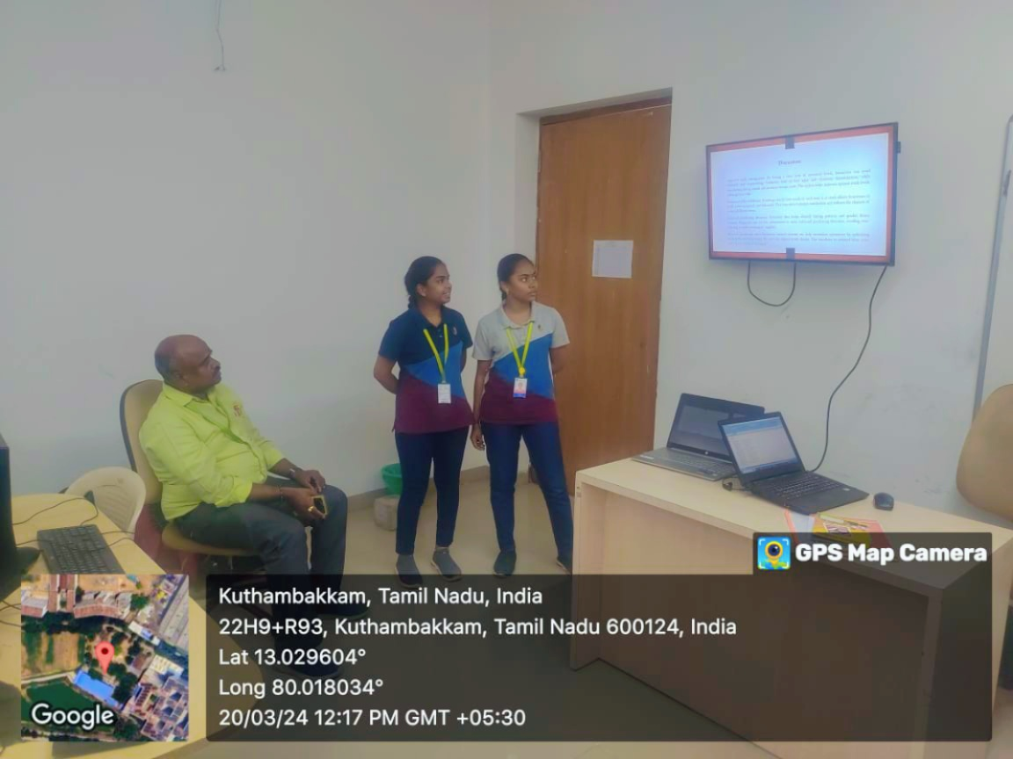

Slide 13


